Slide 1


Monte Carlo Tree Search
Presentation

Slide 2





Group Members
Ossama Mehmood
Zaid Ghauri
Hamza Altaf
Abdullah
Sami Ali

Slide 3

Table Of Contents
01
Background Knowledge
02
Introduction
03
Steps of MCTS
04
Real Life Examples
06
Conclusion

Slide 4

Background Knowledge
Monte Carlo Tree Search (MCTS) is an important algorithm behind many major successes of recent AI applications such as AlphaGo’s striking showdown in 2016.
MCTS has been shown to outperform traditional search algorithms in many scenarios, and has been widely adopted in game AI and other decision-making applications.

Slide 5

Introduction
Monte Carlo tree search (MCTS) is a heuristic search algorithm for decision making in games and other decision-making scenarios that involves uncertainty.
MCTS has been applied successfully to a wide range of games, including Go, chess, and others.

Slide 6
Introduction
Monte Carlo Tree Search is a method usually used in games to predict the path (moves) that should be taken by the policy to reach the final winning solution.
It is a type of "tree search" algorithm, which means that it starts with a single state (or node) and expands the tree of possible moves from that state until it reaches a pre-determined depth.

Slide 7

Steps of
MCTS
Selection
Expansion
In this step, we use tree policy to construct path from root to most promising leaf node.
In expansion step, we simply randomly pick an unexplored node of a leaf node.
Simulation (or Roll-out)
Backup
During this step, we roll out one or multiple simulations with reward accumulated for each simulation.
We use the accumulated rewards of simulations to back up and update the values of nodes in the snowcap.

Slide 8
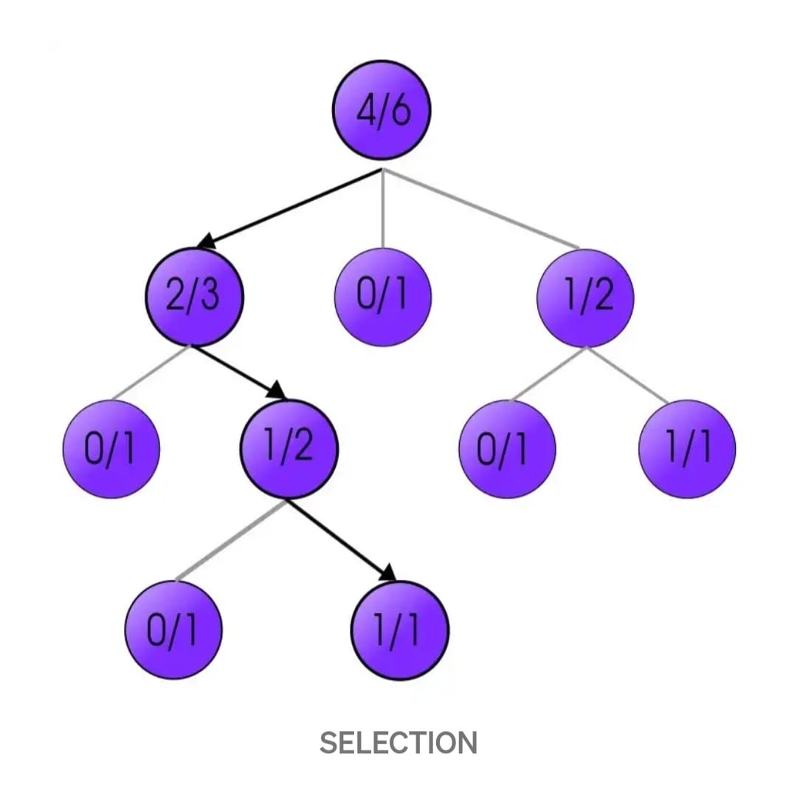
Selection
In this step, we use tree policy to construct path from root to most promising leaf node. A leaf node is a node which has unexplored child node(s).

Slide 9

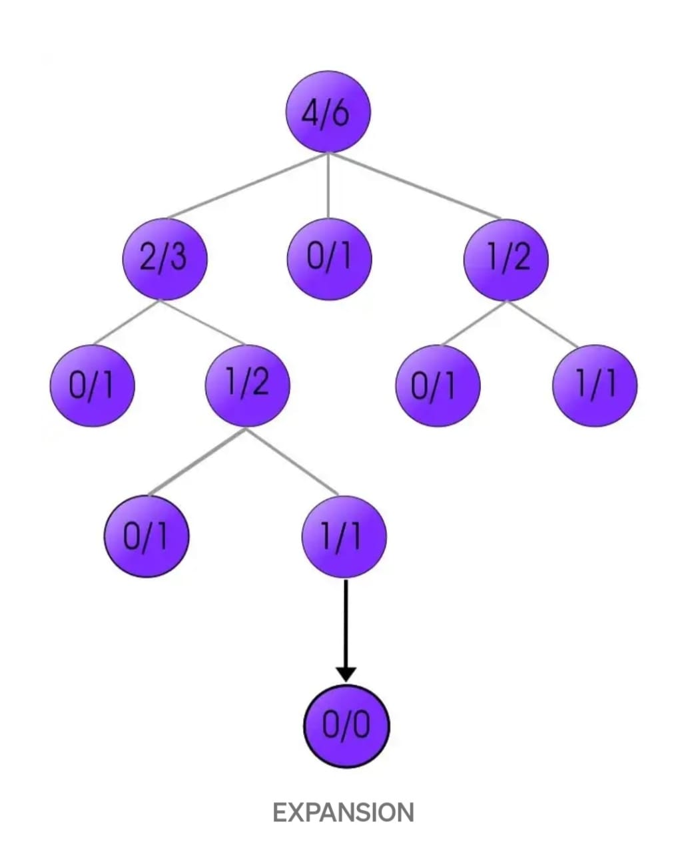
Expansion
Remember that we reach a leaf node at the end of selection?
In expansion step, we simply randomly pick an unexplored node of a leaf node.

Slide 10
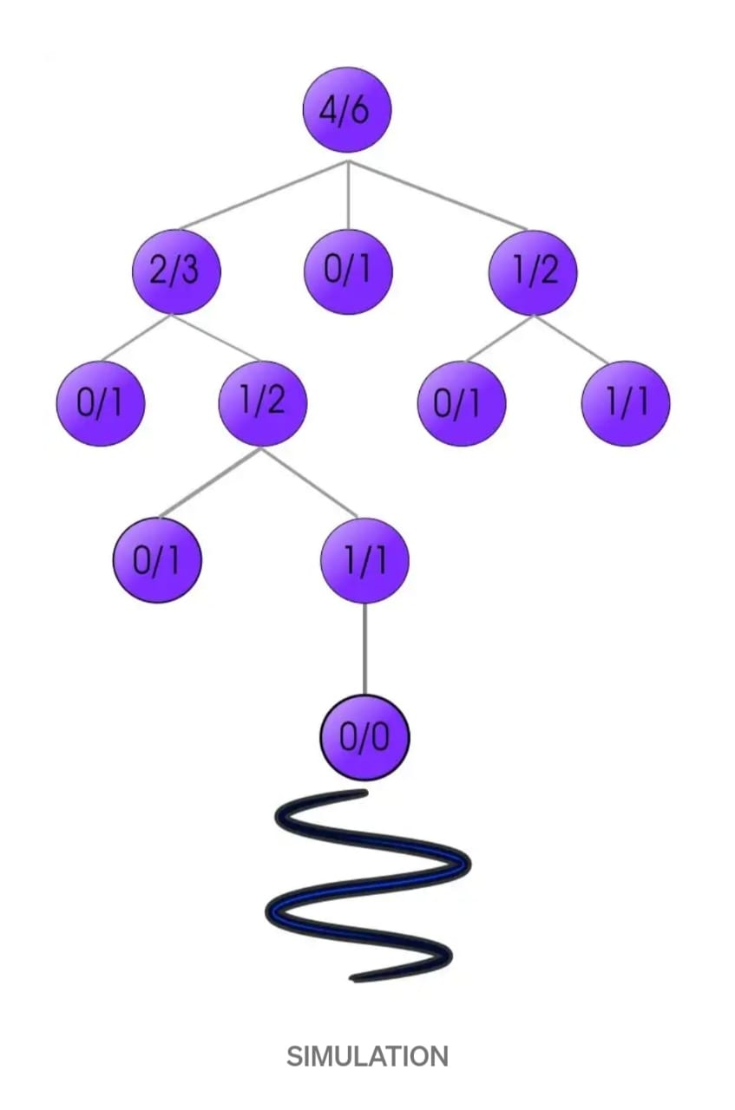
Simulation (or Roll-out)
During this step, we roll out one or multiple simulations with reward accumulated for each simulation.
For example, a win might induce reward of +1, a draw for 0, and a loss for -1.

Slide 11
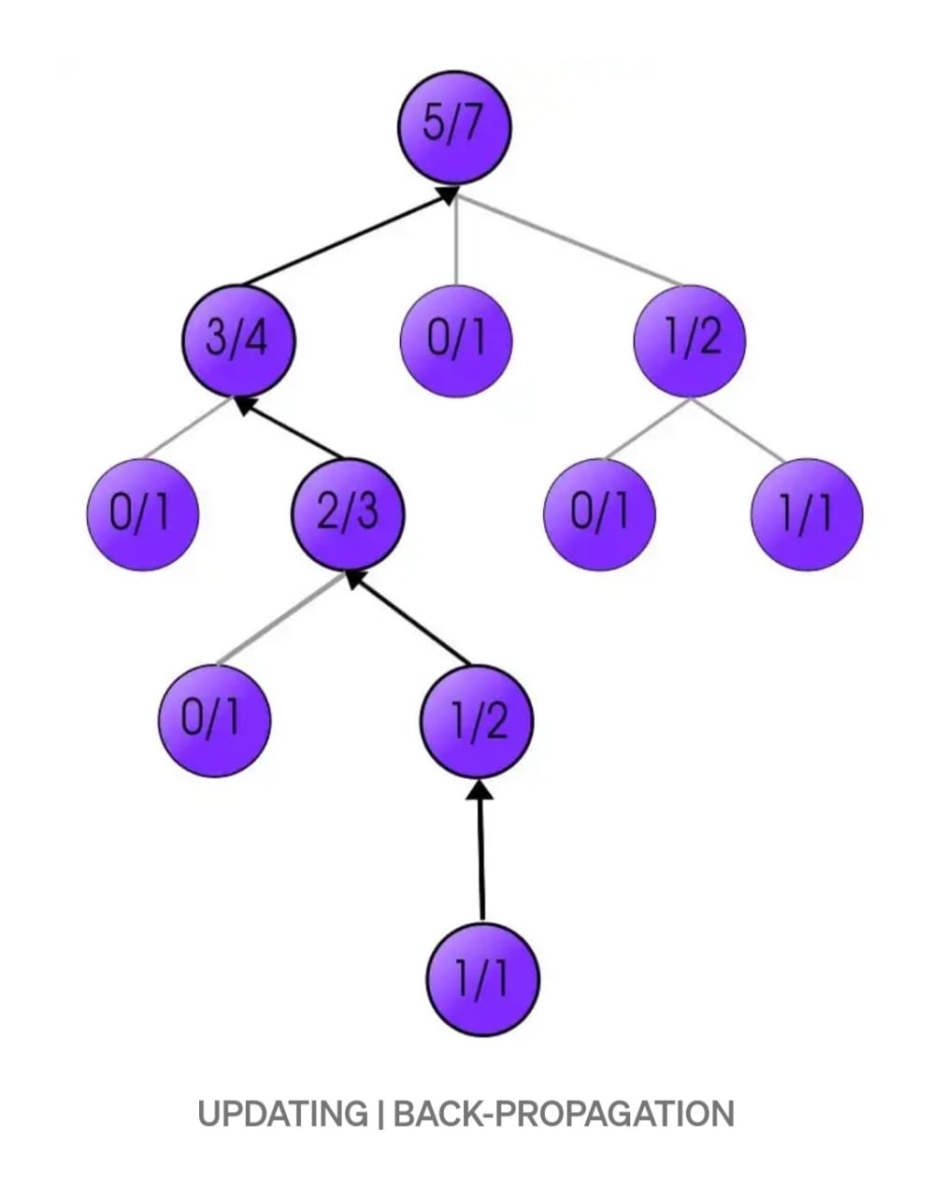
Backup (or Update) :
Now we have played out many simulations, what can we do with it to inform the best next move?
We use the accumulated rewards of simulations to back up and update the values of nodes in the snowcap.

Slide 12
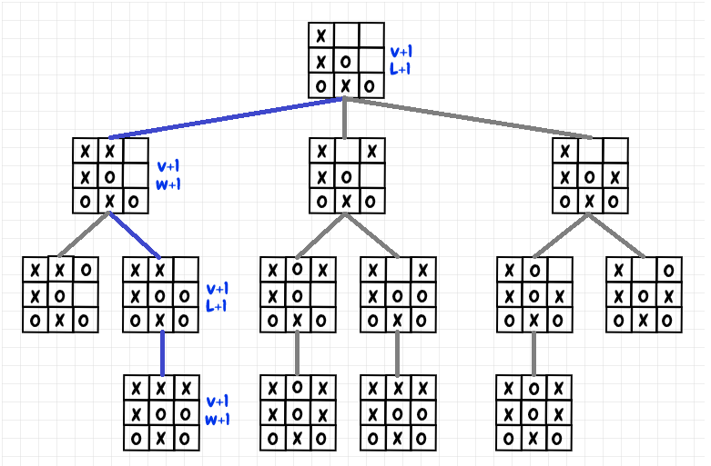
Tic Tac Toe example:

Slide 13

Real Life Example
Five (5) Real-Life examples of MCTS :
Autonomous vehicles using Monte Carlo Tree Search to determine the best route to a destination
Notes:
Photo by Remy Gieling on Unsplash
<a href='https://www.freepik.com/photos/virtual-reality'>Virtual reality photo created by freepik - www.freepik.com</a>
Microsoft Videos Library

Slide 14
Real Life Example
Stock market trading algorithms utilizing Monte Carlo Tree Search to make investment decisions
Poker bots using Monte Carlo Tree Search to determine the best betting strategy in a hand of poke
Notes:
Photo by Remy Gieling on Unsplash
<a href='https://www.freepik.com/photos/virtual-reality'>Virtual reality photo created by freepik - www.freepik.com</a>
Microsoft Videos Library

Slide 15
Real Life Example
Game playing : MCTS is used in game-playing AI to help the AI make decisions in real-time. For example, Chess computer programs
Weather Forecast : Monte Carlo Tree Search algorithms used in weather forecasting.
Notes:
Photo by Remy Gieling on Unsplash
<a href='https://www.freepik.com/photos/virtual-reality'>Virtual reality photo created by freepik - www.freepik.com</a>
Microsoft Videos Library

Slide 16
Conclusion
The Conclusion of MCTS is that it can evaluate a large number of potential moves in a relatively short amount of time, making it useful for games with complex decision-making processes. It has been successfully applied to a wide range of games, including Go, chess, and poker.
This makes it a powerful tool for solving a wide range of challenging problems in AI and decision-making.

Slide 17
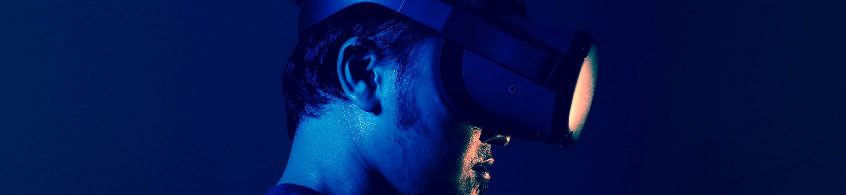
Many of AI problems have its roots in search problems. After all, life is about searching. Hope you all find your optimal path : )
Thank You!

